Slide 1
Key Logger Using Python
An application that keeps a track
of all the stroked keys in a log file.

Slide 2
Agenda Style
01
Introduction
02
Workflow
03
GitHub Setup
04
Work Progress
05
Alpha Testing

Slide 3
Introduction
Keystroke logging, often referred to as keylogging or keyboard capturing, is the action of recording (logging) the keys struck on a keyboard, typically covertly, so that a person using the keyboard is unaware that their actions are being monitored. Data can then be retrieved by the person operating the logging program. A keystroke recorder or keylogger can be either software or hardware.

Slide 4



Our Team
I Kaustubh
M Abhiram
Manohar Karthik
GitHub Setup and Workflow
Research and Development
Development and Workflow

Slide 5
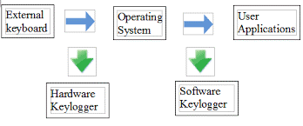
Working of a Keylogger

Slide 6


Infographic Style
Keyboard
Stores keys in a log file
Application Keylogger

Slide 7
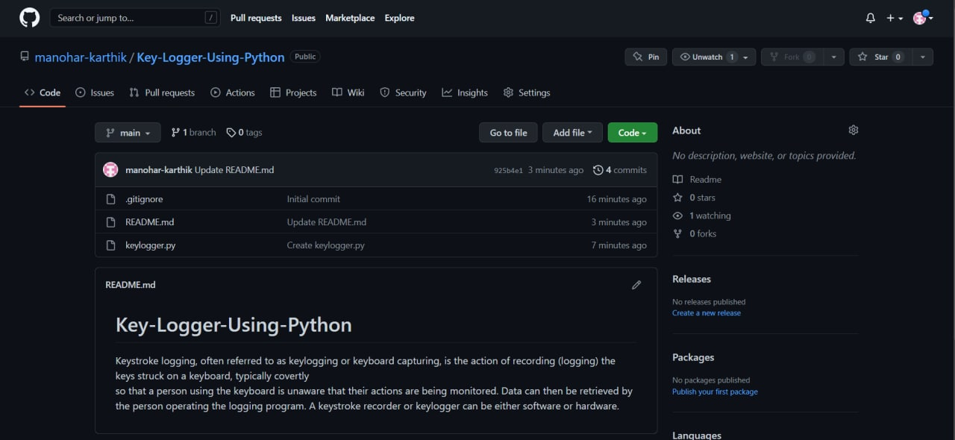
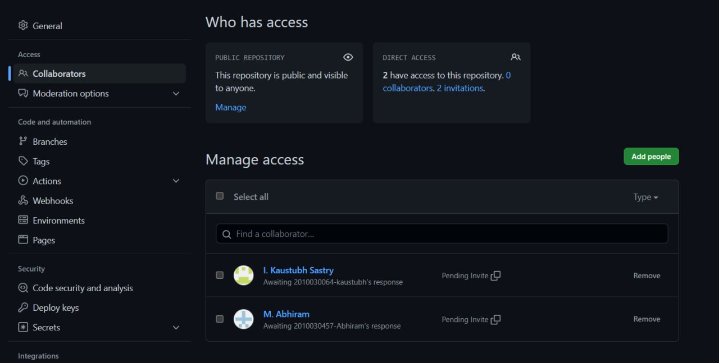
GitHub Setup

Slide 8
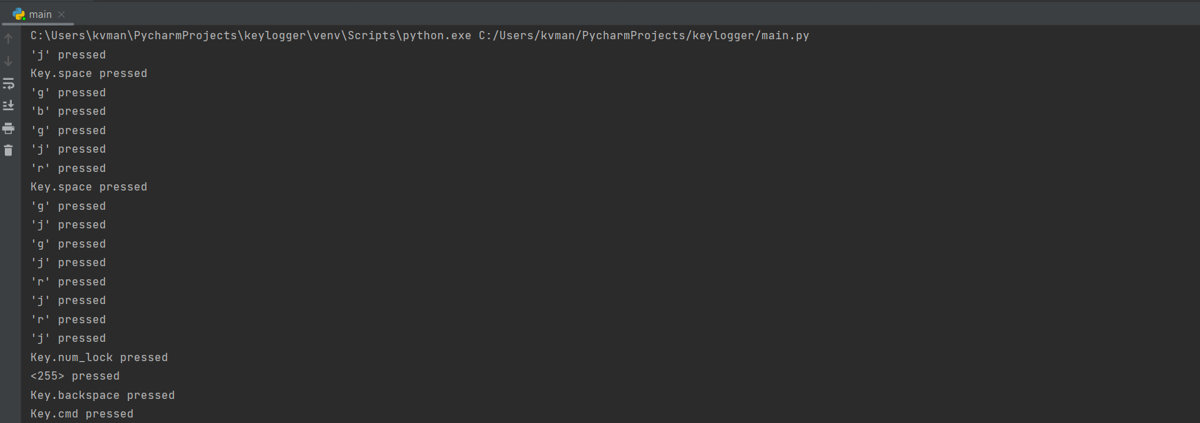
Implementation
Output
Stores every key that is pressed in the terminal of the .py exe file.

Slide 9
Alpha Testing
We have developed a keylogging python program which shows the keys pressed on the keyboard in the output screen of the program.
When we are trying to store the stroked keys in a log.txt file, The program is being detected by windows security and being abandoned.
So we are trying to develop a keylogging program which stores the stroked keys in a log.txt file without being detected to windows security.
We are also trying to develop a system where the .py file sends mail automatically

Slide 10
THANK YOU

